Slide 1




HEART DISEASE PREDICTION USING MACHINE LEARNING
Presented by: Glitch Fix
Group Members:
Pooja Kushwaha
Shubham
Mannu Yadav
Md Sahanawaz Hussain
Gaurav
College: IIT Madras

Slide 2
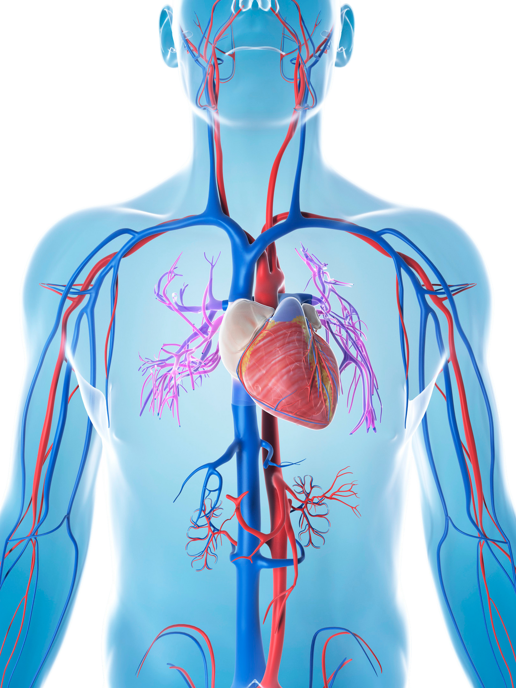
INTRODUCITON
Heart Disease Overview
A leading cause of global mortality, affecting millions.
Early detection can prevent severe complications like heart attacks and strokes.
Current Challenges
A leading cause of global mortality, affecting millions.
Early detection can prevent severe complications like heart attacks and strokes.
Potential Solution
Machine learning model for non-invasive, efficient heart disease risk prediction.

Slide 3

PROBLEM STATMENT
Objective
Develop a machine learning model to predict heart disease risk based on medical and demographic data.
Specific Goals
Data collection and preprocessing.
Feature selection and engineering.
Model development and integration with Flask and Gemini AI.
Model evaluation and validation.
Ethical and practical considerations.

Slide 4

SUSTAINABLE DEVELOPMENT GOAL
Goal Chosen: Good Health and Well-Being
Early detection of heart disease to reduce mortality and improve patient outcomes.
Rationale
High prevalence of heart disease globally.
Potential to reduce healthcare burden through early intervention.

Slide 5
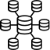
DATA COLLECTION AND PREPROCESSING
Data Collection
Collects 13 medical parameters (e.g., age, sex, cholesterol, chest pain type) via a chatbot interface.
Uses Gemini AI for conversational, empathetic data collection.
for tanning model ( used Kaggle data set after cleaning ) :
raw dataset: https://www.kaggle.com/code/caesarmario/listen-to-your-heart-a-disease-prediction
Input Validation
Validates user inputs using regex and predefined ranges for each parameter (e.g., age: 1–120, cholesterol: 100–600 mg/dl).
Ensures data suitability for model predictions.
Feature Selection and Engineering
Fixed set of 13 features: age, sex, cp, trestbps, chol, fbs, restecg, thalach, exang, oldpeak, slope, ca, thal.
Descriptions provided to users (e.g., sex: 1 = male, 0 = female; cp: chest pain type).

Slide 6

MODEL DEVELOPMENT
Algorithm Used: Random Forest Classifier
Random Forest Classifier (loaded as heat_diease_model.pkl).
Ensemble method for robust predictions, suitable for high-dimensional medical data.
Model Training and loading
Train the model using the preprocessed dataset.
Use cross-validation to ensure model stability and prevent overfitting.
Uses joblib to load a trained model.
Prediction Logic
Accepts 13 validated inputs in a specific order.
Outputs binary prediction (0 = LOW RISK, 1 = HIGH RISK) and probability (if available).

Slide 7

TOOLS AND RESOURCES
Flask Framework
Description: Python web framework for hosting the application.
Usage: Serves the chatbot interface and handles prediction requests.
Gemini AI
Description: Google’s AI model for natural language processing.
Usage: Powers the HeartDiseaseBot for empathetic, conversational data collection.
Joblib
Description: Library for loading pre-trained machine learning models.
Usage: Loads the Random Forest model for predictions.

Slide 8

DEPLOYMENT
Chatbot Interface
Built with Flask and HTML templates (chat.html).
Collects user inputs sequentially, validates them, and provides clear explanations (e.g., “What is your age in years?”).
Uses Gemini AI for professional, reassuring responses.
Model Integration
Deployed via Flask, enabling real-time predictions.
Users receive risk assessment (e.g., “HIGH RISK” or “LOW RISK”) with confidence scores.
Error Handling
Handles missing model files, invalid inputs, and prediction errors gracefully.
Provides user-friendly error messages (e.g., “Please clarify your response for cholesterol level”).

Slide 9

MODEL IMPACT AND EFFECTIVENESS
Problem Solving
Early Detection: Identifies high-risk individuals for timely intervention.
Non-Invasive: Collects data through a simple chatbot, no medical procedures needed.
Scalable: Web-based deployment allows integration into healthcare platforms or mobile apps.
Why It Will Work
Conversational Interface: Gemini AI ensures user-friendly, empathetic interaction.
Robust Model: Random Forest handles complex medical data effectively.
Scalable Infrastructure: Flask enables deployment across diverse systems.
Ethical Design: Includes disclaimers emphasizing consultation with healthcare professionals.
Error Handling
Handles missing model files, invalid inputs, and prediction errors gracefully.
Provides user-friendly error messages (e.g., “Please clarify your response for cholesterol level”).

Slide 10

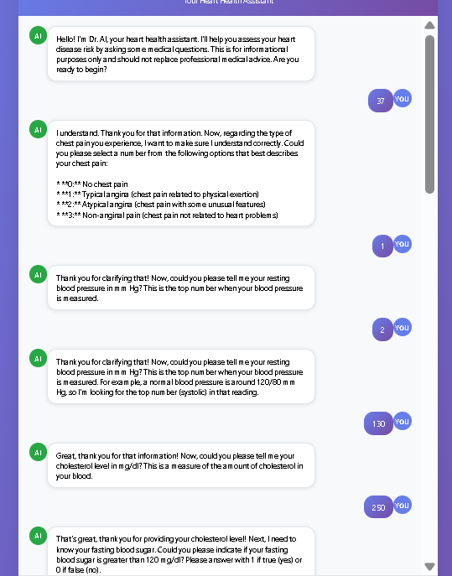
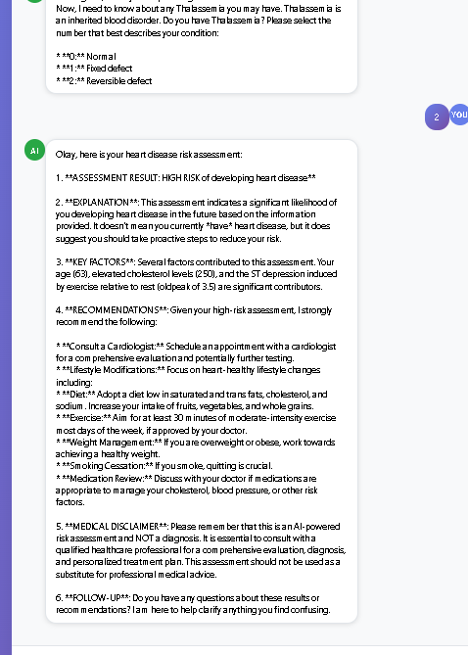
RESULTS
INPUT DATA

Slide 11

RESULTS
Prediction Example
Input Data: Age: 50, Sex: Male (1), Chest Pain: 2, Cholesterol: 200, etc.
Output: “LOW RISK of developing heart disease (Model Confidence: 85%)” or “HIGH RISK (Model Confidence: 70%)”.
Conclusion
Developed a heart disease prediction model using a Random Forest Classifier.
Integrated with Flask and Gemini AI for a user-friendly, conversational interface.
Provides non-invasive, scalable risk assessment with clear disclaimers.
Future Work
Integrate with larger datasets for model retraining.
Enhance chatbot with multilingual support.
Address ethical considerations like data privacy and model bias.

Slide 12

REFERENCES/LINKS
Deploy App
https://hearth-1.onrender.com/
Raw Data Set Link:
https://www.kaggle.com/code/caesarmario/listen-to-your-heart-a-disease-prediction
Trained Model Link:
https://github.com/Shubham17112/hearth/tree/main/model
Github Code Link:
https://github.com/Shubham17112/hearth
Demo video Link:

